Slide 1
Installing and using Zotero reference management software

Slide 2
ZOTERO management referencing software
A free (open source) reference tool that
- recognizes bibliographic information on books, journal articles, websites and databases and extracts metadata from these sources
- stores related citations, PDFs, files, images, and links in your library
- creates citations and references in Word or OpenOffice documents
Works with different browsers like Google Chrome, Microsoft Edge, and Firefox
Is available for Mac, Windows and Linux operating system

Slide 3
Steps
1. Download and install the software
2. Install Zotero Connector depending on the browser your using (Chrome, Firefox, Edge)
3. Install the Microsoft Word Plug-in or Adds-on
4. Insert citations and references/bibliographies

Slide 4
Download and install Zotero software
Visit http://www.zotero.org/download
Click to download (download show at the left hand corner of your window
After download, run to install the software

Slide 5
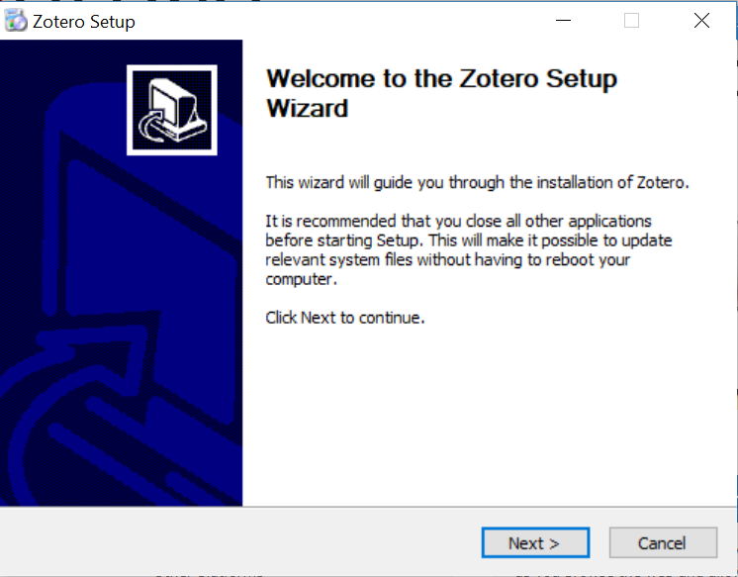
Zotero setup wizard
Click Next

Slide 6
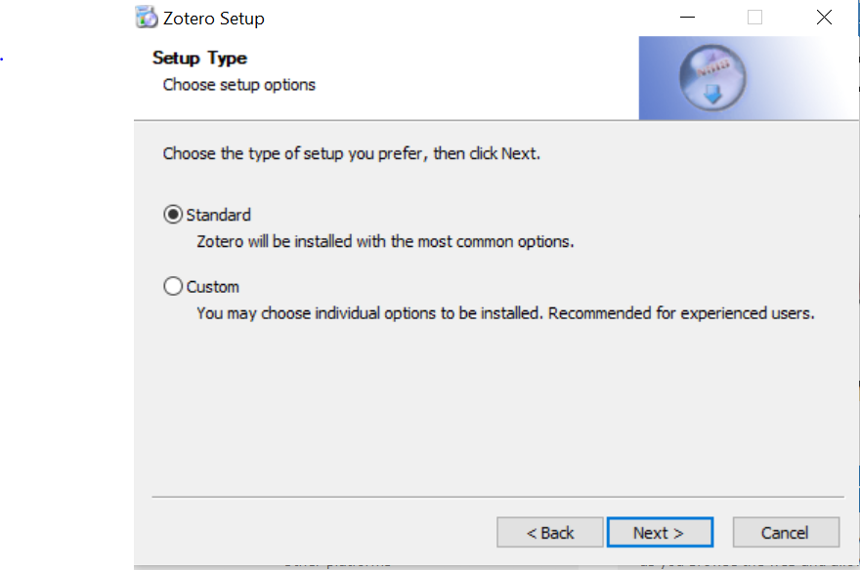
Zotero setup wizard
Follow
Select/choose
Click Next

Slide 7
Installing the tool
Click to install

Slide 8
Finish the installation
Click to finish installation

Slide 9
Zotero desktop shortcut
Zotero desktop shortcut after successful installation

Slide 10
Zotero window

Slide 11
Zotero connector/extension
After successful installation of Zotero, a connector/extension should be added
Connector/extension helps to save resources like journal articles, books, websites etc
Extension will be inform of Z visible on the address bar regardless of the browser.
Zotero Extension

Slide 12
Zotero browser connectors
Google chrome Zotero connector
Visit http://www.zotero.org/download
Chrome browser icon
Zotero icon
Click to install Chrome connector

Slide 13
Zotero browser connectors
2. Microsoft Edge Zotero connector
Visit http://www.zotero.org/download
Mirosoft Edge browser icon
Zotero icon
Click to install Microsoft Edge connector

Slide 14
Zotero browser connectors
3. Mozilla Firefox zotero connector
Visit http://www.zotero.org/download
Mozilla Firefox browser icon
Zotero icon
Click to install Firefox connector

Slide 15
Zotero browser connector
4. Brave
No-longer running on brave browser since 4th March 2021

Slide 16
Zotero icons
The extension icon changes depending on publication type your saving e.g book, article, website, newspaper article etc.
PDF document Website Newspaper article
Folder of items

Slide 17
Zotero Window
Zotero menu
Section for metadata
Section for the saved items
Section for Collections
Section for authors

Slide 18
Zotero menu
1. Tools menu – Add Word Add-ons/Plug-in
1. Go to Tools menu
2. Click on Add-ons
3. Enable the Add-ons depending on the software your using either Windows or Libreoffice e.g

Slide 19
Integration of Zotero into MS Word document
Zotero Word plug-in
Adding in-text citation and references/bibliography

Slide 20
Zotero menu
2. File menu (for adding new item manually, new collection or importing references)
Add a “New item” manually for example a physical book, a case, conference paper without an electronic version, feed in the metadata manually
File menu
Add new collection
From other tools like Mendeley

Slide 21
Zotero menu
3. Edit menu – adding the referencing style
Different styles to choose the preferred style then click OK
1. Click on Edit menu
2. Choose Preferences
3. Zotero preference box will open up then click on Cite
Get additional style in case the preferred is not enlisted

Slide 22
Creating collections/folders for items
Type the name of the collection e.g Trial 1 and click OK

Slide 23
Adding items/citations to Zotero
You can add items to zotero in several ways
- Import information for a single item
- Import information for multiple items
- Manually enter items
- Automatically cite web pages
- Add an item by identifier (ISBN, DOI)
Each publication type will have a different icon
Activate the collection your to save to

Slide 24
Adding a PDF item
Z icon changes to a PDF icon
Click to save to the PDF to the folder we created “Trial 1”

Slide 25
Adding a website
Zotero icon
Click to save to zotero or the created folder

Slide 26
Adding item(s) from a list
1. Click on the extension to extract a list of items
2. Select the items you have used
3. Click OK and the items will be added to Zotero

Slide 27
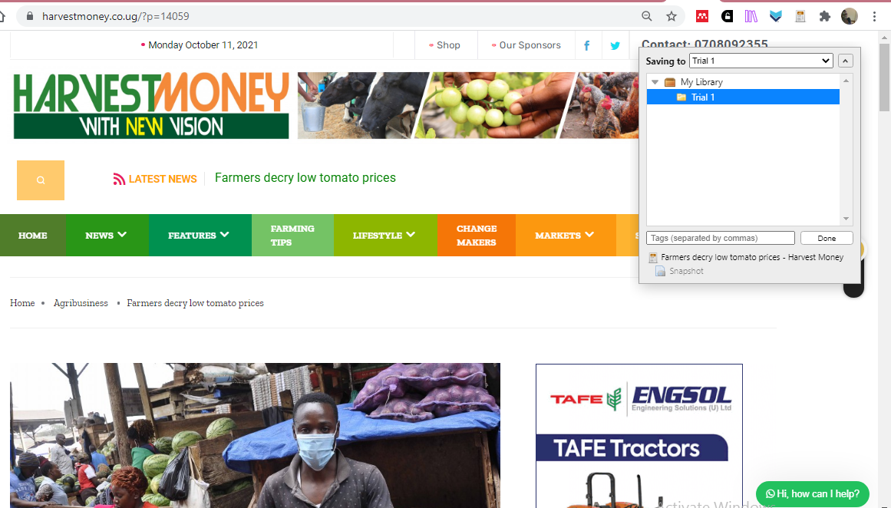
Adding newspaper article
Click on the extension to save to the folder

Slide 28
Adding an item by an identifier (ISBN, DOI)
Add ISBN or DOI
Click on the identifier

Slide 29
Adding an item manually
Click File
Choose the publication type you want to save
Click new item
Input the item metadata

Slide 30
Item with Metadata
Captured metadata for the Item

Slide 31
Items added to the collection
Collection
Added items (books, website, newspaper article
Item metadata

Slide 32
Retrieving missing metadata
Right click on the document without metadata
Click on retrieve metadata from the pop dialog box
Edit where necessary

Slide 33
Point to note
Have both your Microsoft Word and Zotero windows open when working
Create a page for the reference before you start adding them

Slide 34
Adding in-text citations in MS Word document
Click on Zotero
Place the cursor where you want to add in-text citation
Type the author’s name for the in-text citation
Click Ok
The citation will be added

Slide 35
Adding references/bibliographies
After the first initial in-text citation, place your cursor on the reference page
Click on Zotero
Add bibliographies/references
The reference will be inserted
(Only do the above for the first time, the subsequent times the reference will automatically be added once in-text citation is added)

Slide 36
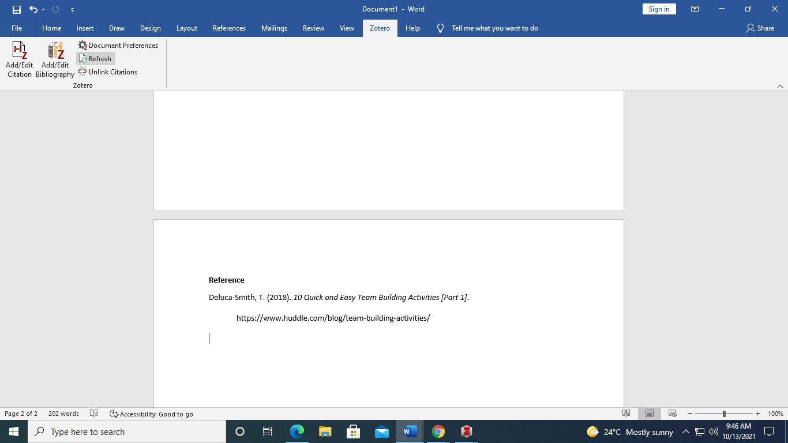
Adding reference/bibliography
The references will be arranged alphabetically
Click on Zotero
Click to add bibliography/reference
For the first time. The subsequent times the references will be automatically added the moment you add an in-text citation

